Slide 1

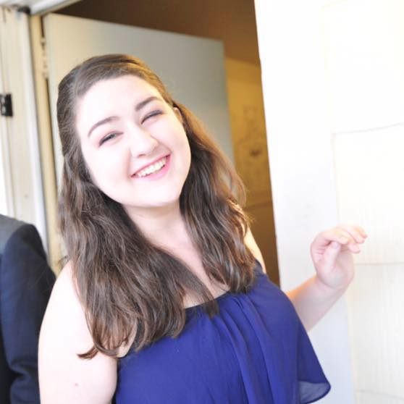
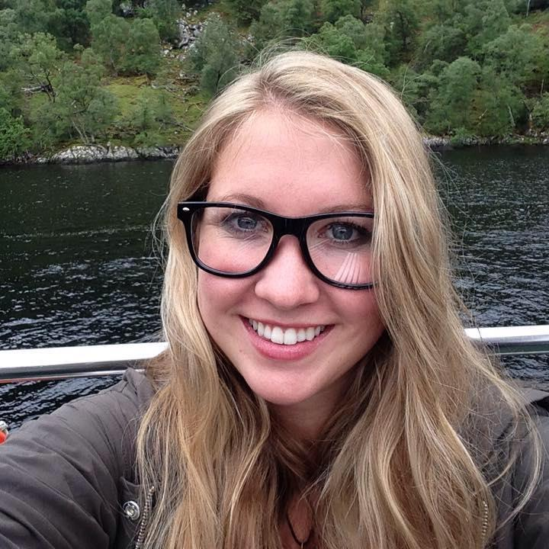
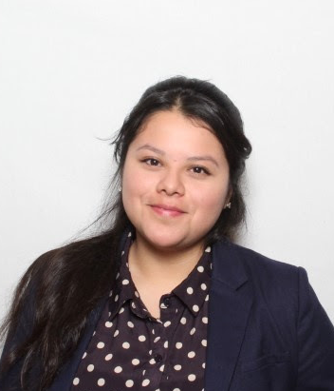
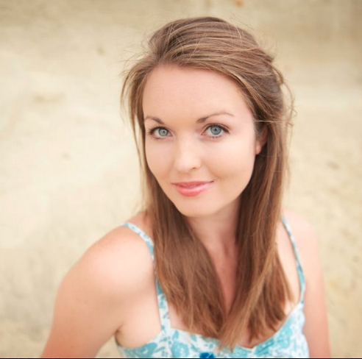


Kayla MIssman
Journalist
Kristen Keks
Journalist
Diana Guardado
Designer
Casey Freeman
Filmmaker
Alivia Blount
Engineer
Chloe Yuqing Jiang
PR Professional

Slide 2
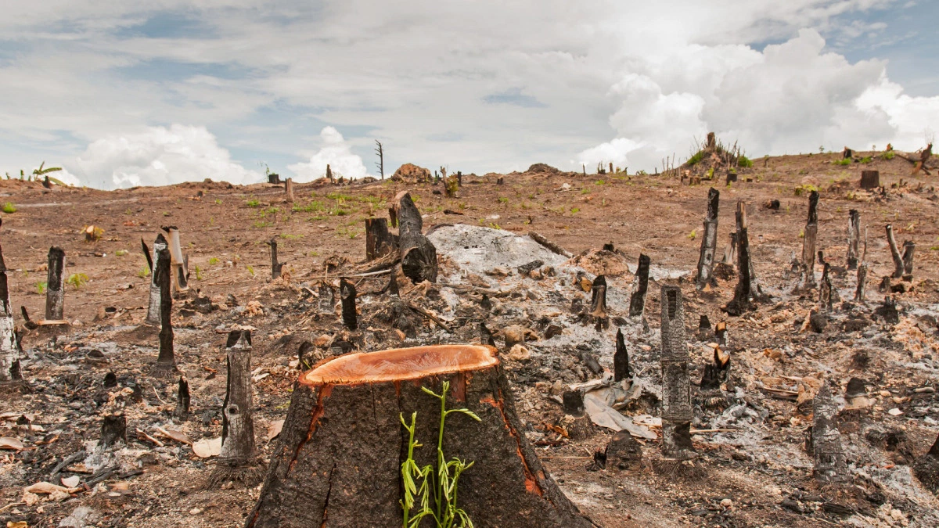
Notes:
Imagine being transported to…...deforestation, melting ice caps, or witnessing the santa barbara oil spill

Slide 3
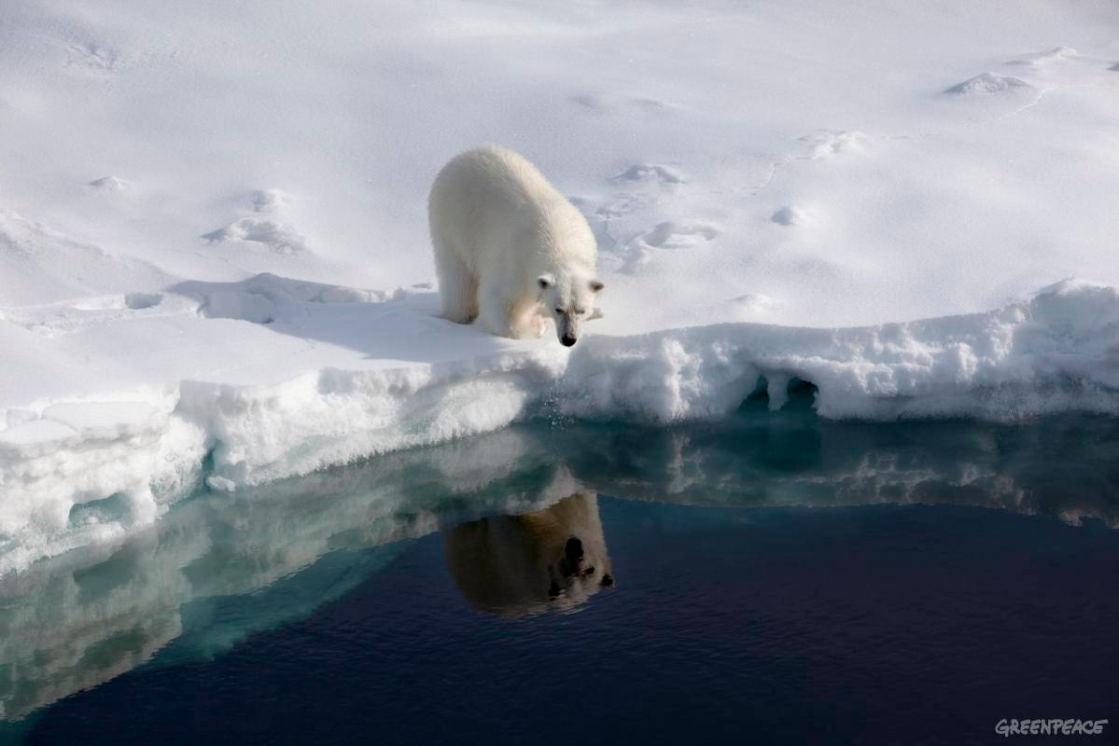

Slide 4
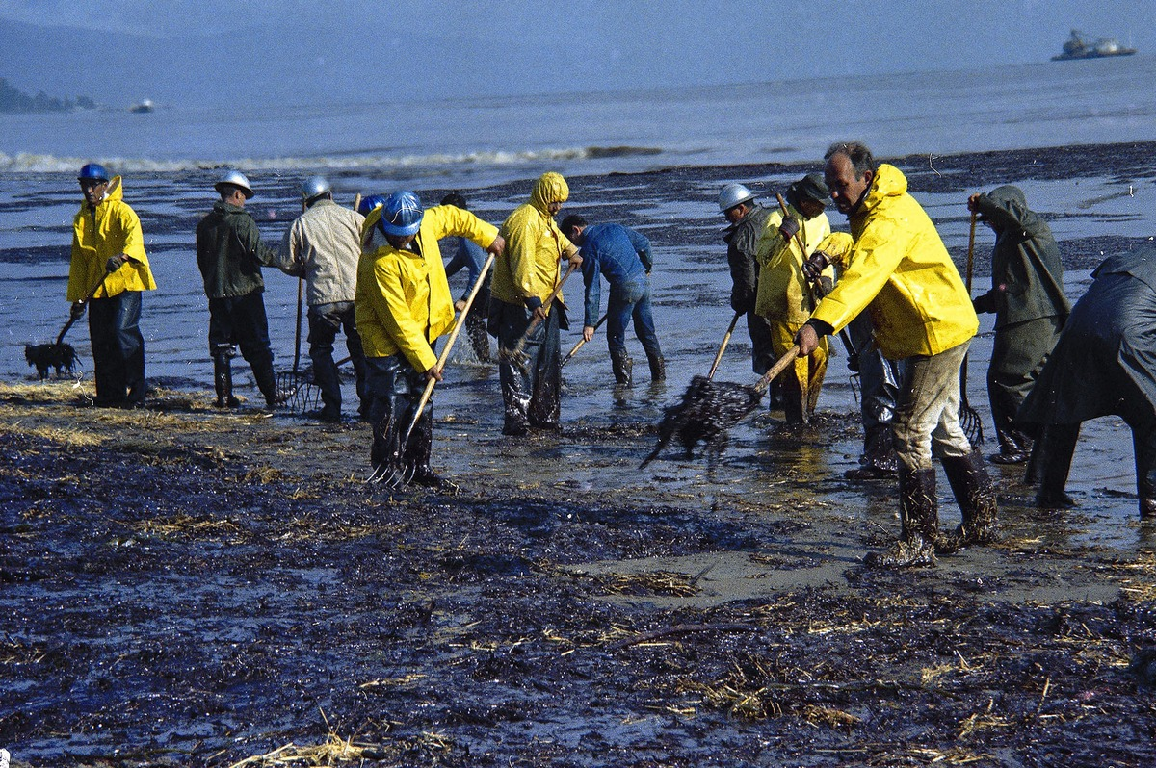
Notes:
These are environmental stories that need to be told. But you can’t just read about them—for real change to happen, we need to experience it. That’s what we believe at Habitat.

Slide 5
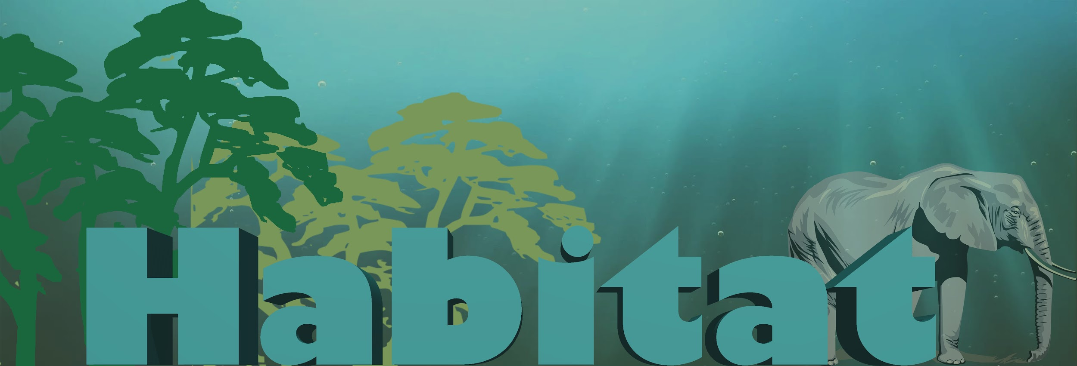
Habitat
Notes:
Habitat is an environmental news channel built specifically for virtual reality
NPR was built for radio, CNN was built for broadcast and BuzzFeed was built for digital. We are the first movers in the VR space—giving us an edge as this new platform emerges. Habitat is a team of journalists, filmmakers, developers and environmentalists with a social mission. We believe that you simply can’t understand the impact of environmental issues unless you’re there … so we will transport you to the scene through our storytelling app.
By partnering with NGOs to develop social impact campaigns, we will make a difference through innovation.
We will also commission independent producers and partner with NGOs to develop social impact campaigns.
Sample project: Examples: projecting the future, experiencing “then and now”

Slide 6
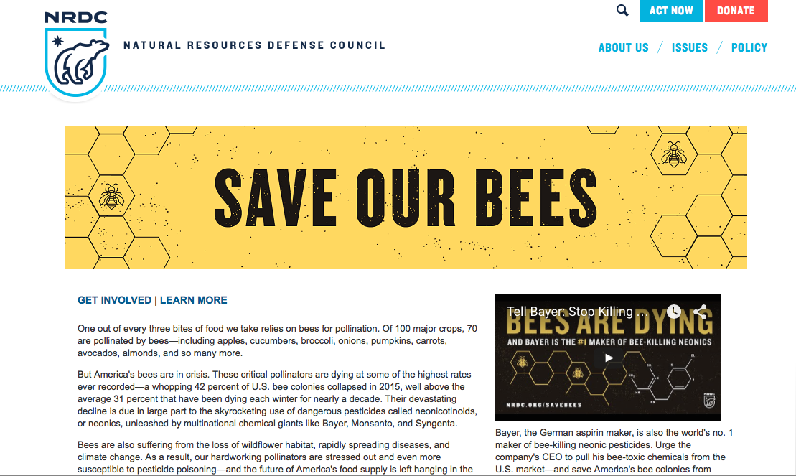
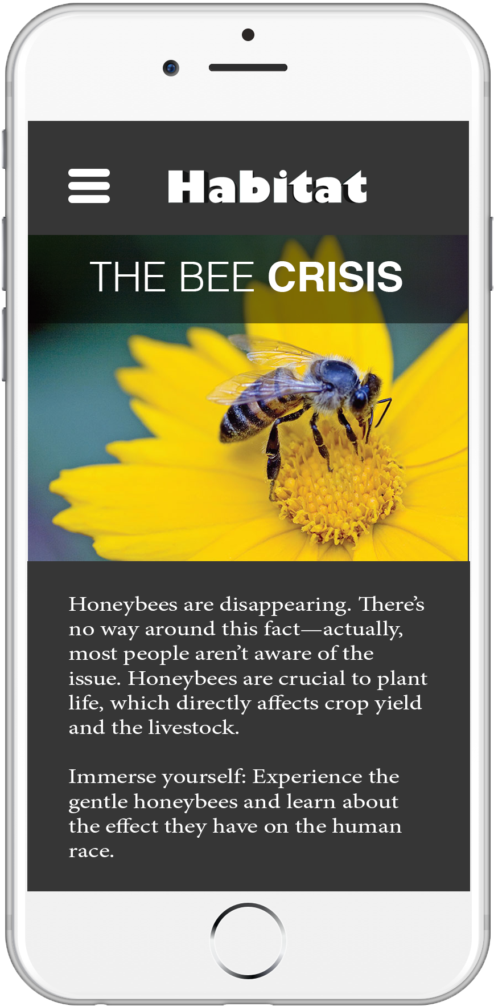
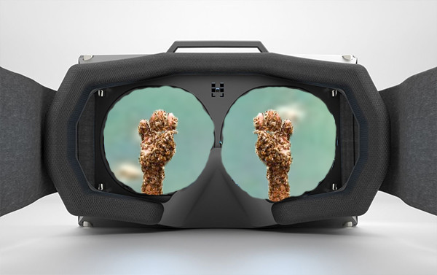
Notes:
Take for example the honey bee crisis ... we want to teach about the crisis currently going on with the bees slowly dying off in our world.

Slide 7
Mission statement
We will be the first movers in the virtual reality space, telling powerful, original stories about the environment in compelling ways.
Notes:
We are targeting early adopters of the virtual reality platform
target market:
As a content company specifically focused on this medium of storytelling.

Slide 8
Here’s how.
Notes:
Slide about technology

Slide 9
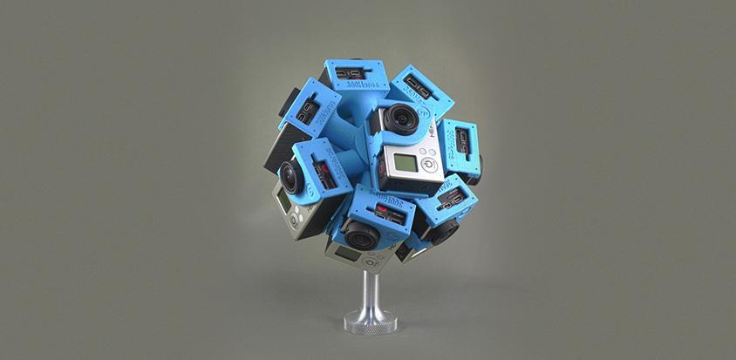
Technology
Notes:
The technology
Use the 360 heros camera holster and 6 Go-pro cameras and the wireless remote to capture video content. The holster works like a floating drone. The SD cards are removed and the content is uploaded 360 Heros platform to stitch the. The remote allows all 6 cameras to record at the same time syncing the recording. Frame by frame the images are then reformatted to create a flat view of the footage.

Slide 10
Meet our audience.

Slide 11
61%
of millennials want to change the world
Notes:
Target audience:
People who already use VR & Millennials
According to a study “ Cone Millennial Cause Study”
Over 80% of survey respondents volunteer
61% worried about state of world and feel a need to change it
They are “Pro - Social”
***really need to mention that VR is the next hot space, and we will be ahead of the competition as milennials adopt this

Slide 12
Marketing
Social: Facebook/Twitter ads
Build a following on Youtube - introduce them to a virtual reality channel
Environmental non-profits partnership
Notes:
http://www.greenpeace.org/international/Global/international/publications/greenpeace/2014/472-AnnualReport2013.pdf
At Habitat we are going to promote our app by creating ads to be shown on popular social media outlets such as Twitter and Facebook. This is the perfect platform to be advertising to our target audience, millenials. We will also be creating videos on youtube that give the viewer a small slice of what our emerging experience is going to be and create a following through them. We will also be featured on youtube through popular channels that already have an avid following of environmental activists. Our app will be partnering with environmental non-profits to help promote awareness and action in helping save the wildlife and the environment. We will take you out of your Habitat to help save theirs.

Slide 13
Funding
Partnerships
Kickstarter and investment
Subscription

Slide 14
Costs
$10,000 Equipment
$20,000 Contract Journalists
$10,000 Video Editors
$1,000,000 build Technology for VR platform

Slide 15
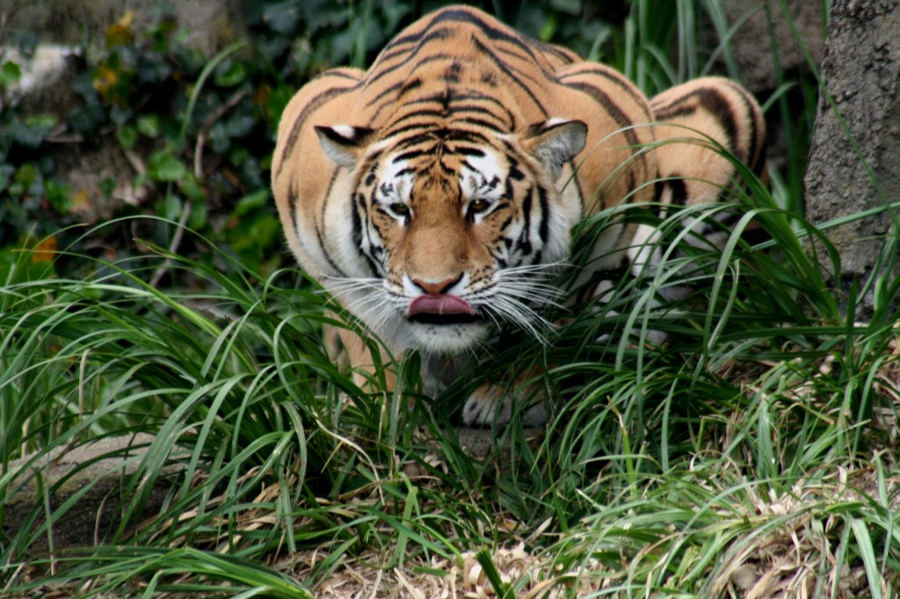

Slide 16
We will take you out of your habitat to help save theirs.

Slide 17
